Slide 1
CSE 465 Lecture 1
Introduction

Slide 2
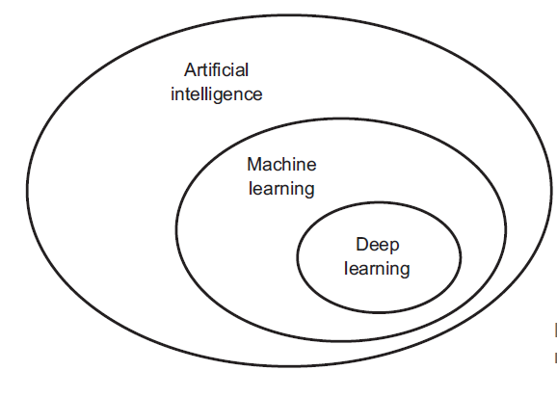
AI vs Machine Learning vs Deep Learning

Slide 3
AI
As the name suggests, artificial intelligence can be loosely interpreted as incorporating human intelligence to machines
Artificial intelligence is the broader concept that consists of everything from Good Old-Fashioned AI all the way to futuristic technologies such as deep learning
Whenever a machine completes tasks based on a set of stipulated rules that solve problems – if that could be termed as “intelligent” behavior, then it is artificial intelligence

Slide 4
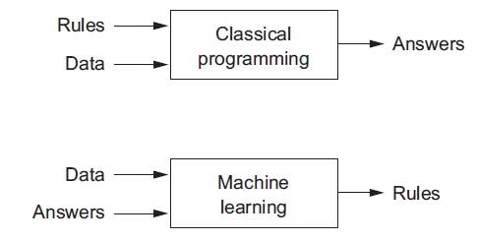
Machine Learning

Slide 5
Machine Learning Basics
Machine learning is a field of computer science that gives computers the ability to learn without being explicitly programmed
Labeled Data
Machine Learning algorithm
Training
Prediction
Unlabeled Data
Learned model
Prediction
Methods that can learn from and make predictions on data

Slide 6
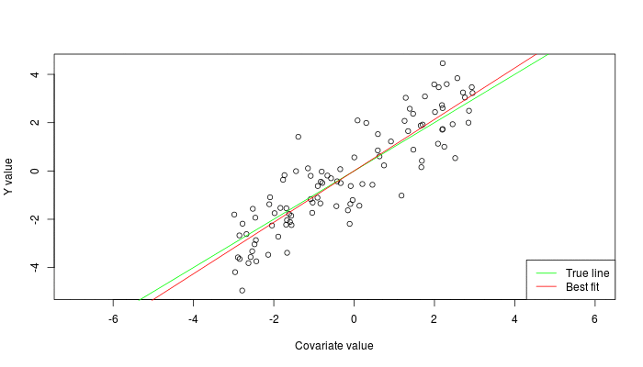


Types of Learning
Supervised: Learning with a labeled training set
Example: email classification with already labeled emails
Unsupervised: Discover patterns in unlabeled data
Example: cluster similar documents based on text
Reinforcement learning: learn to act based on feedback/reward
Example: learn to play Go, reward: win or lose
class A
class A
Classification
Regression
Clustering
Anomaly Detection
Sequence labeling
…

Slide 7
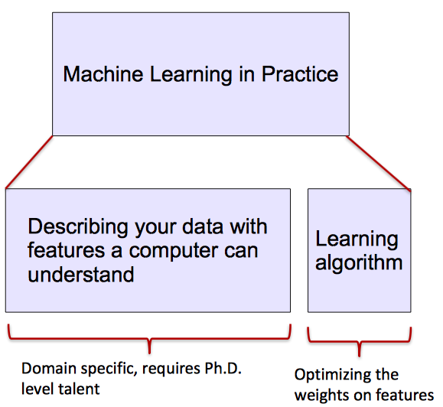
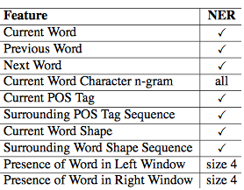
ML vs. Deep Learning
Most machine learning methods work well because of human-designed representations and input features
ML becomes just optimizing weights to best make a final prediction

Slide 8

What is Deep Learning (DL) ?
A machine learning subfield of learning representations of data. Exceptional effective at learning patterns.
Deep learning algorithms attempt to learn (multiple levels of) representation by using a hierarchy of multiple layers
If you provide the system tons of information, it begins to understand it and respond in useful ways.

Slide 9
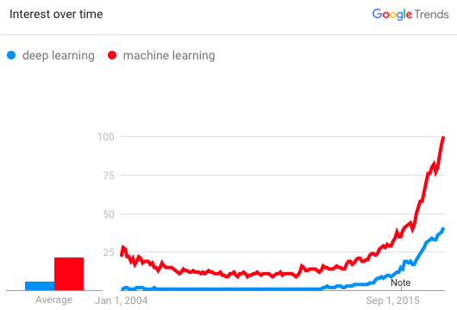
Why is DL useful?
Manually designed features are often over-specified, incomplete and take a long time to design and validate
Learned Features are easy to adapt, fast to learn
Deep learning provides a very flexible, (almost?) universal, learnable framework for representing world, visual and linguistic information.
Can learn both unsupervised and supervised
Effective end-to-end joint system learning
Utilize large amounts of training data
In ~2010 DL started outperforming other ML techniques
first in speech and vision, then NLP

Slide 10
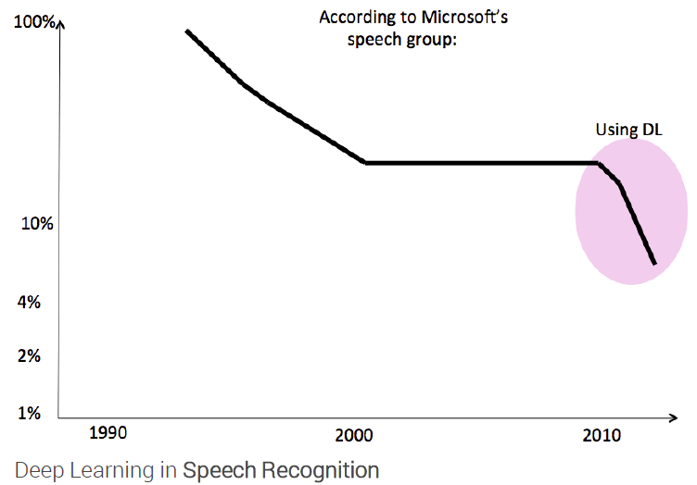
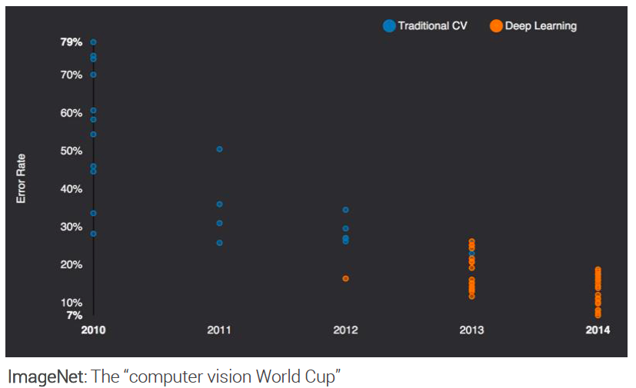
State of the art in …
Several big improvements in recent years in NLP
Machine Translation
Sentiment Analysis
Dialogue Agents
Question Answering
Text Classification …
Leverage different levels of representation
words & characters
syntax & semantics

Slide 11
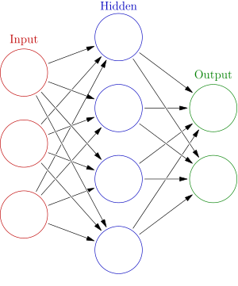
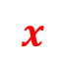
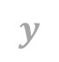

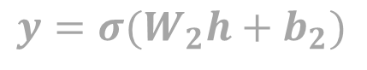

Neural Network
Weights
$$h= σ(W_{1}x+b_{1})$$
$$y=σ(W_{2}h+b_{2})$$
Activation functions
How do we train?
$$y$$
$$x$$
$$h$$

Slide 12

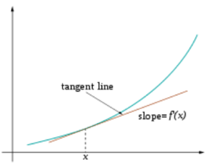
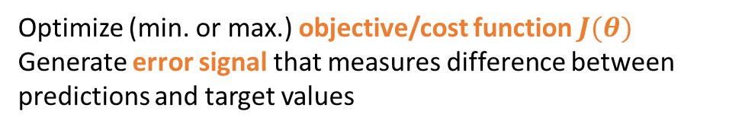
Training
Sample labeled data
(batch)
Forward it through the network, get predictions
Back-propagate the errors
Update the network weights
Optimize (min. or max.) objective/cost function $J(θ)$
Generate error signal that measures difference between predictions and target values
Use error signal to change the weights and get more accurate predictions
Subtracting a fraction of the gradient moves you towards the (local) minimum of the cost function

Slide 13
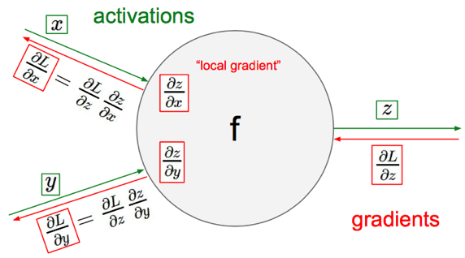
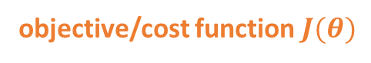
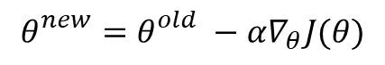
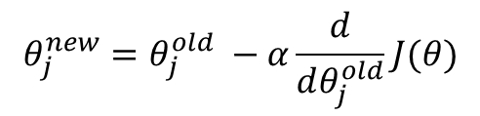
Optimization: Gradient Descent
objective/cost function $J(θ)$
$$θ_{j}^{new}=θ_{j}^{old} −α\frac{ⅆ}{ⅆθ_{j}^{old}}J(θ)$$
Update each element of θ
$$θ_{}^{new}=θ_{}^{old} −α∇_{θ}J(θ)$$
Matrix notation for all parameters
learning rate
Recursively apply chain rule though each node
Notes:
Adaptive Gradient Algorithm (AdaGrad) that maintains a per-parameter learning rate that improves performance on problems with sparse gradients (e.g. natural language and computer vision problems).
Root Mean Square Propagation (RMSProp) that also maintains per-parameter learning rates that are adapted based on the average of recent magnitudes of the gradients for the weight (e.g. how quickly it is changing). This means the algorithm does well on online and non-stationary problems (e.g. noisy).
Adam realizes the benefits of both AdaGrad and RMSProp.
Instead of adapting the parameter learning rates based on the average first moment (the mean) as in RMSProp, Adam also makes use of the average of the second moments of the gradients (the uncentered variance).
Specifically, the algorithm calculates an exponential moving average of the gradient and the squared gradient, and the parameters beta1 and beta2 control the decay rates of these moving averages.
The initial value of the moving averages and beta1 and beta2 values close to 1.0 (recommended) result in a bias of moment estimates towards zero. This bias is overcome by first calculating the biased estimates before then calculating bias-corrected estimates.

Slide 14
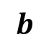

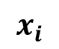
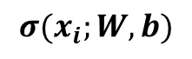
Optimization: One forward pass
Text (input) representation
TFIDF
Word embeddings
….
0.2 | -0.5 | 0.1
2.0 | 1.5 | 1.3
0.5 | 0.0 | 0.25
-0.3 | 2.0 | 0.0
0.1
0.2
0.3
1.0
3.0
0.025
0.0
0.95
3.89
0.15
0.37
very positive
positive
negative
very negative
$$W$$
$$x_{i}$$
$$b$$
$$σ(x_{i};W, b)$$

Slide 15
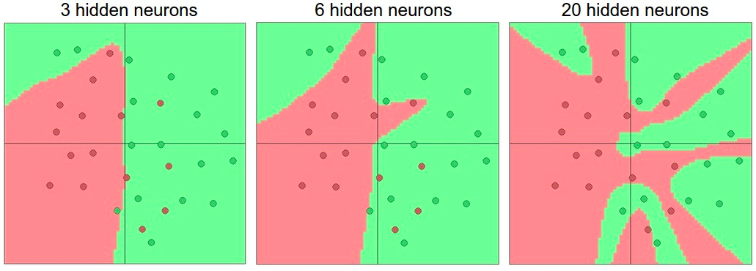
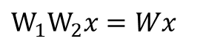
Activation function
Non-linearities needed to learn complex (non-linear) representations of data, otherwise the NN would be just a linear function
More layers and neurons can approximate more complex functions
$W_{1}W_{2}x=Wx$

Slide 16
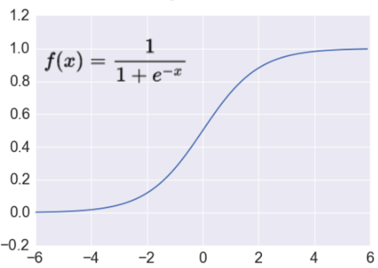
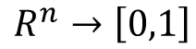
Activation: Sigmoid
Takes a real-valued number and “squashes” it into range between 0 and 1.
$$R^{n}→\left[0,1\right]$$
http://adilmoujahid.com/images/activation.png
Nice interpretation as the firing rate of a neuron
0 = not firing at all
1 = fully firing
Sigmoid neurons saturate and kill gradients, thus NN will barely learn
when the neuron’s activation are 0 or 1 (saturate)
gradient at these regions almost zero
almost no signal will flow to its weights
if initial weights are too large then most neurons would saturate

Slide 17
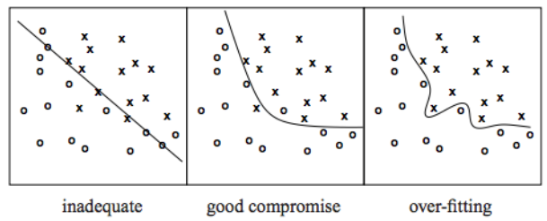
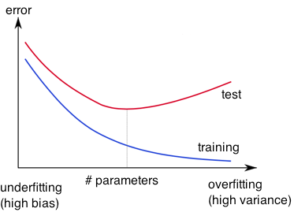
Problem: Overfitting
Learned hypothesis may fit the training data very well, even outliers (noise) but fail to generalize to new examples (test data)

Slide 18
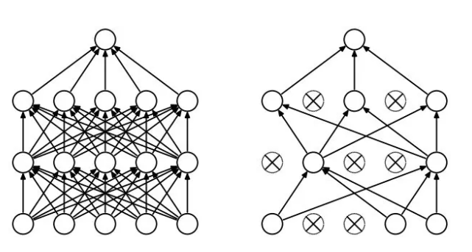
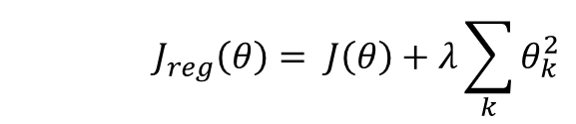
Solution: Regularization
Dropout
Randomly drop units (along with their connections) during training
Each unit retained with fixed probability p, independent of other units
Hyper-parameter p to be chosen (tuned)
Srivastava, Nitish, et al. "Dropout: a simple way to prevent neural networks from overfitting." Journal of machine learning research (2014)
L2 = weight decay
Regularization term that penalizes big weights, added to the objective
Weight decay value determines how dominant regularization is during gradient computation
Big weight decay coefficient → big penalty for big weights
$$J_{reg}\left(θ\right)= J\left(θ\right)+λ\sum_{k}{θ_{k}^{2}}$$
Early-stopping
Use validation error to decide when to stop training
Stop when monitored quantity has not improved after n subsequent epochs
n is called patience

Slide 19
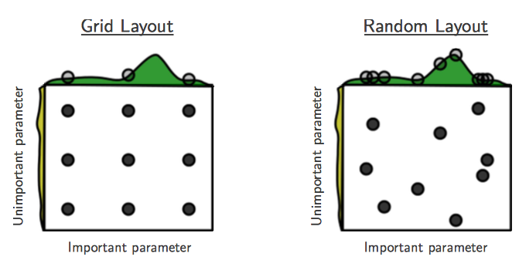
Tuning hyper-parameters
g(x) ≈ g(x) + h(y)
g(x) shown in green
h(y) is shown in yellow
Bergstra, James, and Yoshua Bengio. "Random search for hyper-parameter optimization." Journal of Machine Learning Research, Feb (2012)
“Grid and random search of 9 trials for optimizing function g(x) ≈ g(x) + h(y)
With grid search, nine trials only test g(x) in three distinct places.
With random search, all nine trials explore distinct values of g. ”
Both try configurations randomly and blindly
Next trial is independent to all the trials done before
Bayesian optimization for hyper-parameter tuning:
Make smarter choice for the next trial, minimize the number of trials
Collect the performance at several configurations
Make inference and decide what configuration to try next

Slide 20
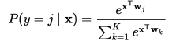

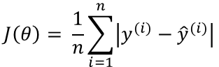
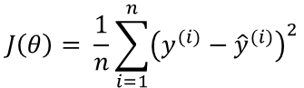
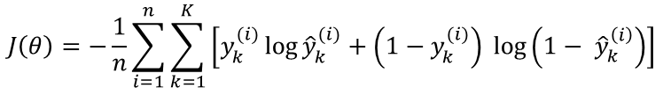
Loss functions and output
Classification
Regression
Training
examples
R^{n} x {class_1, ..., class_n}
(one-hot encoding)
R^{n} x R^{m}
Output
Layer
Soft-max
[map R^{n} to a probability distribution]
Linear (Identity)
or Sigmoid
f(x)=x
Cost (loss)
function
Cross-entropy
Mean Squared Error
$$J\left(θ\right)= \frac{1}{n}\sum_{i=1}^{n}{{\left(y^{(i)}−{\hat{y}}^{(i)}\right)}^{2}}$$
$$J\left(θ\right)=−\frac{1}{n}\sum_{i=1}^{n}{\sum_{k=1}^{K}{\left[y_{k}^{(i)}\log{{\hat{y}}_{k}^{(i)}+\left(1−y_{k}^{(i)}\right) }\log\left(1− {\hat{y}}_{k}^{\left(i\right)}\right)\right]}}$$
Mean Absolute Error
$$J\left(θ\right)= \frac{1}{n}\sum_{i=1}^{n}{\left|y^{(i)}−{\hat{y}}^{(i)}\right|}$$
Notes:
Exponentiate to make it positive
MSE has nice mathematical properties which makes it easier to compute the gradient
Because of the square, large errors have relatively greater influence on MSE.
Therefore, MAE is more robust to outliers since it does not make use of square.

Slide 21
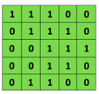

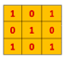
Convolutional Neural Networks (CNNs)
Main CNN idea for text:
Compute vectors for n-grams and group them afterwards
Example: “this takes too long” compute vectors for:
This takes, takes too, too long, this takes too, takes too long, this takes too long
Convolutional
3x3 filter
Input matrix

Slide 22
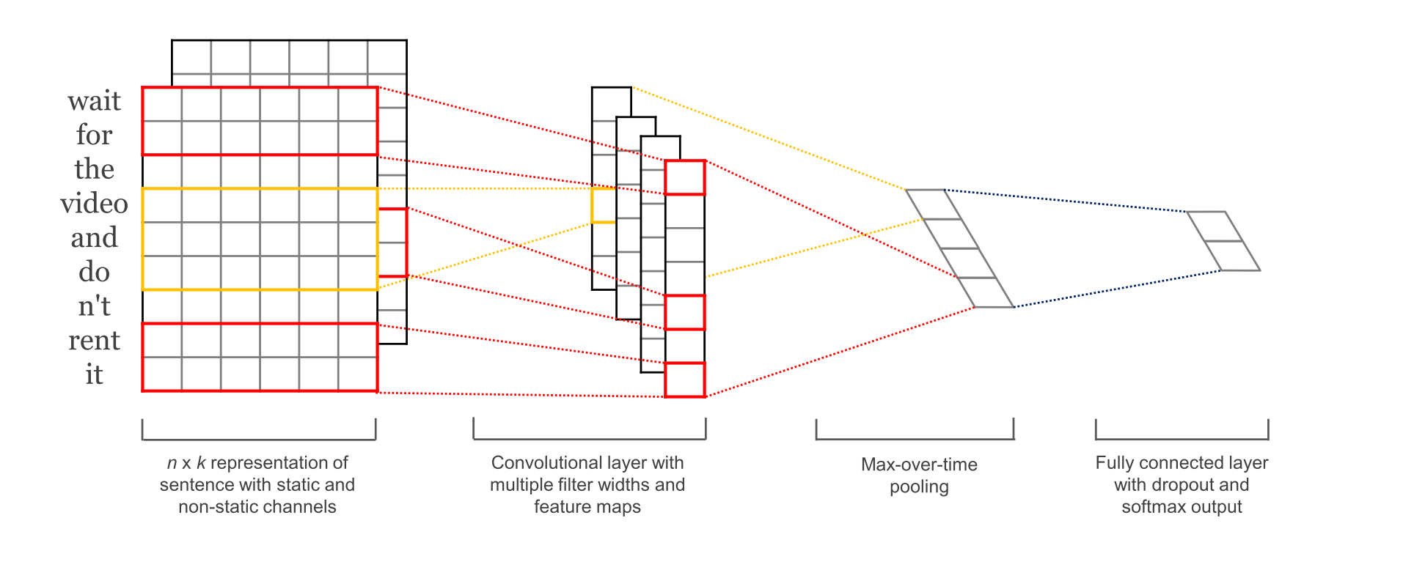
CNN with multiple filters
Kim, Y. “Convolutional Neural Networks for Sentence Classification”, EMNLP (2014)
sliding over 3, 4 or 5 words at a time

Slide 23
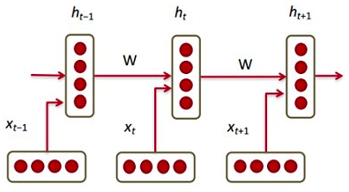
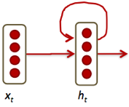

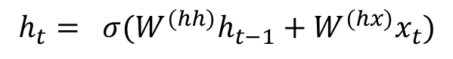
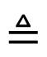
Recurrent Neural Networks (RNNs)
Main RNN idea for text:
Condition on all previous words
Use same set of weights at all time steps
$$h_{t}= σ(W^{(hh)}h_{t−1}+W^{(hx)}x_{t})$$
$$≜$$

Slide 24
GAN (Generative Adversarial Networks)
Generative adversarial networks (GANs) are the most interesting deep learning architectures
This is due to their capability to generate outputs from random noise input vectors
GAN has two networks
Generator
Discriminator
Generator takes a random vector as input and generate sample output data
Discriminator takes input from both the real data and faked data created by the generator
Discriminator determines whether the input is coming from real data or a faked one from the generator

Slide 25
Applications of Deep Learning (Neural Networks)

Slide 26
Self Driving Cars
This is probably the coolest and most promising application of deep learning
An autonomous vehicle has a number of cameras attached to it
The output video stream is fed into deep learning networks that recognize, as well as segment, different objects present around the car
Tesla/NVIDIA/Google has introduced End to End Learning for Self-Driving Cars
These are use convolutional neural network that takes in input images from cameras and predicts what actions should be taken in the form of steering angle or acceleration

Slide 27
Image Translation
One of the interesting applications of GANs is image-to-image translation
It is based on conditional GAN
Given a pair of images holding some relation, say I1 and I2, a conditional GAN learns how to convert I1 into I2
A dedicated software called pix2pix is created to demonstrate the applications of this concept
It can be used to fill in colors to black and white images, create maps from satellite images, generate object images from mere sketches, and what not!

Slide 28
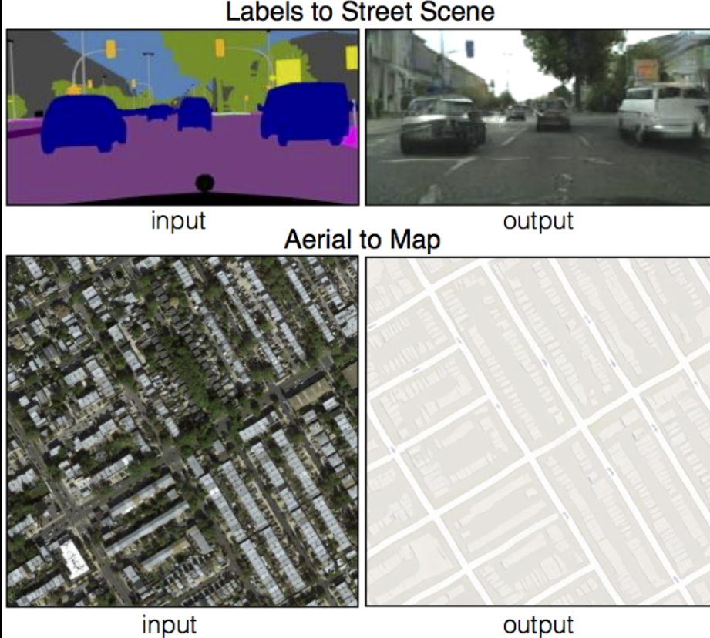
Image Translation

Slide 29
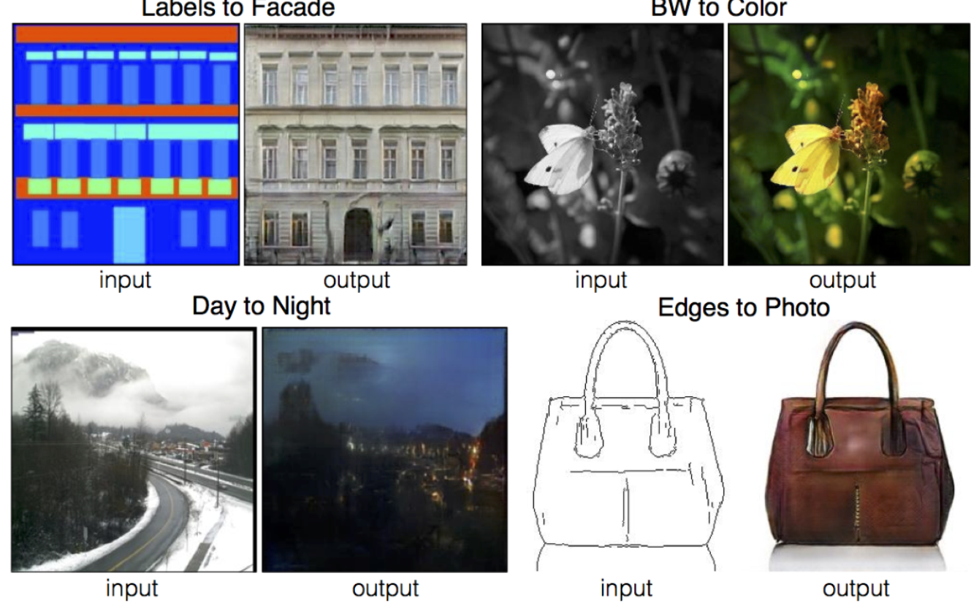
Image Translation

Slide 30
Machine Translation
Neural machine translation models are Recurrent Neural Networks (RNN), arranged in encoder-decoder fashion
The encoder network takes in variable length input sequences through RNN and encodes the sequences into a fixed size vector
The decoder begins with this encoded vector and starts generating translation word by word, until it predicts the end of sentence

Slide 31
Chatbots
Most of the chatbot systems built earlier were based on a knowledge base and rules that define which response to pick from it
This made chatbots a very closed domain and they sounded quite unnatural
But with a little tweaking to the encoder-decoder architecture, we saw machine translation can actually make a chatbot generate a response on its own
The encodings learn the context of the input sentences, and, if the whole architecture is trained on sample queries and responses, whenever the system sees a new query, it can generate its response based on the learning. A lot of platforms like IBM Watson, Bottr, and rasa are building deep learning powered tools to build chatbots for business purposes

